Slide 1

TASK 2 PRESENTATION BY GROUP 21 Requirement Gathering CEF 440 Dr Nkemeni Valery

Slide 2
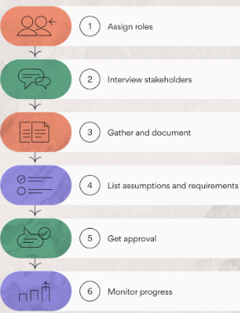
REQUIREMENT GATHERING Objectives:
A complete walk through on the Requirement process, as well as leaning on all the steps to complete the process.
Defining stake holders
Techniques for gathering data
Data gathering process
Data cleaning process
User reluctance assessment

Slide 3
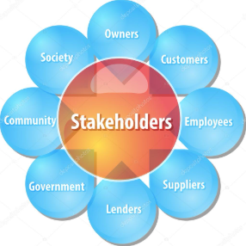
Stake holder identification:
A stakeholder is any person, group, or organization that has an interest in a system, is affected by it, or can influence its success or failure.
Characteristics of stake holders:
Help in decision making
Use the system in real life
Influence design, implementation, and evaluation.
Importance of stake holders:
Improved communication and engagement
Risk management
Better Decision making

Slide 4
Categories of stakeholders
Primary stakeholders or Direct users
Students
Instructors
Secondary stakeholders
System Admin
Developers
External stakeholders
Internet service
Content Providers
Government regulatory bossies

Slide 5
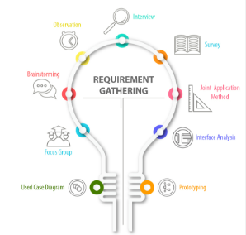
Requirement Gathering Techniques
To ensure that the system requirements are comprehensive, accurate, and aligned with real-world challenges, multiple requirements gathering techniques were employed.
Student Surveys
Focusing on:
Type of devices used for learning
Internet connectivity and stability
Frequency of network interruptions
Challenges faced during online classes
Preferred learning formats (video, audio, text)

Slide 6
Instructor Interviews
Focusing on:
Platforms used for online teaching
Challenges faced during content delivery
Impact of poor network conditions on teaching
Brainstorming
Brainstorming sessions were conducted among group members to generate ideas and define potential system features.
Suggestions from group members:
Automatic video quality adjustment
Switching to audio-only mode
Reverse Engineering

Slide 7
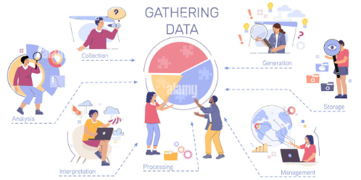
Data Gathering Process
This is based on Quality of Experience (QoE) and was carried out systematically to ensure that the system requirements reflect the real challenges faced by users in low-resource environments such as Cameroon.
Survey Data Collection:
This was mainly designed for the student population
Interview Data Collection:
Designed to get the feedback from the teaching population. Since its proving that hands-on interview might actually be the best way to communicate with the superiors, since they have little or no time for filling survey forms. For the purpose of attaining high end, we interviewed teachers of different backgrounds and fields of studies.
Reverse engineering: Study of pre-existing applications
Brainstorming Sessions: Held with group members for reckoning design

Slide 8
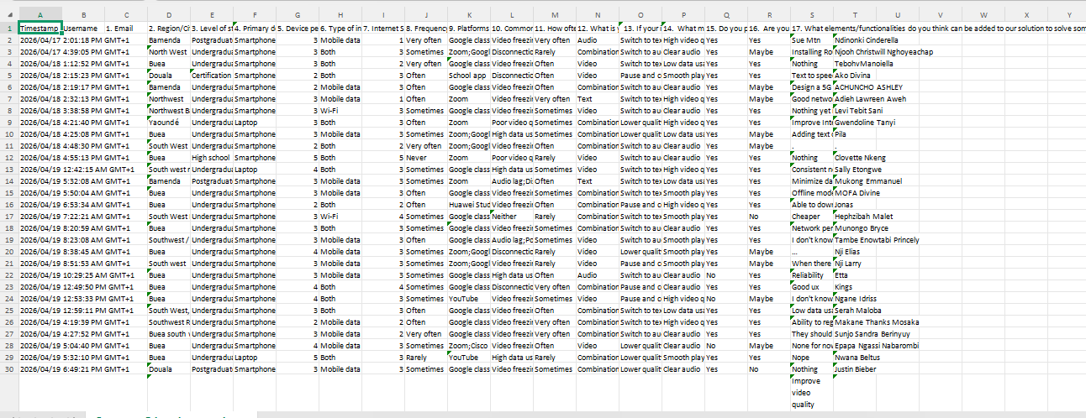

Slide 9

Data Cleaning:
Data cleaning is a walk through to make our data set accurate and efficeint. It involves...
Detecting , correcting, removing incomplete, inaccurate or irrelevant data from the data set.
Importance:
Enhance decision making
Boost operational efficiency
Ensure compliance

Slide 10
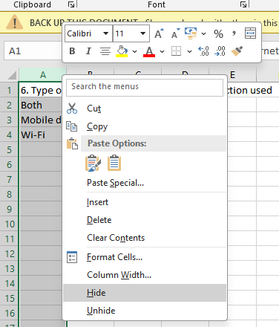
Process through data cleaning:
Checking for duplicates: Identifying identical data and removing
Open-Ends
Removing or hiding responses which are not very important for our aim e.g. emails, dates, etc

Slide 11
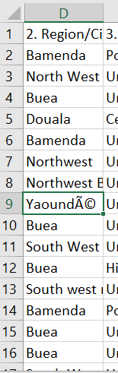
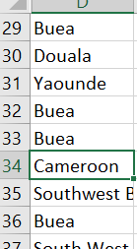
Correcting wrong formats or spellings into the right spellings or so
This will ease the process of analyses and virtualisation
The next was Dividing the data into Qualitative and Quantitative.
Qualitative= What is happening
Quantitative= why it is happening

Slide 12
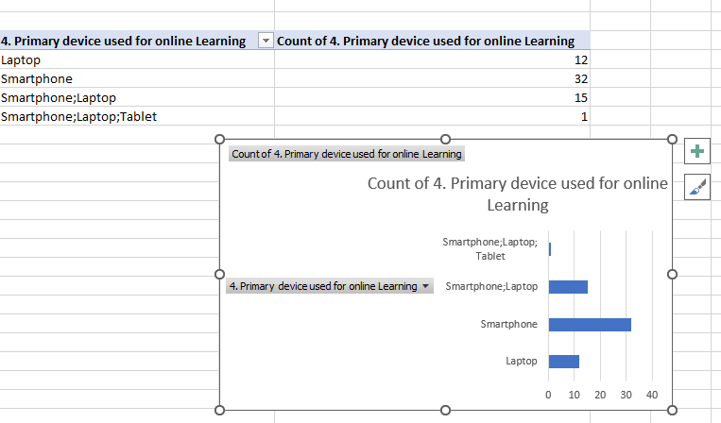
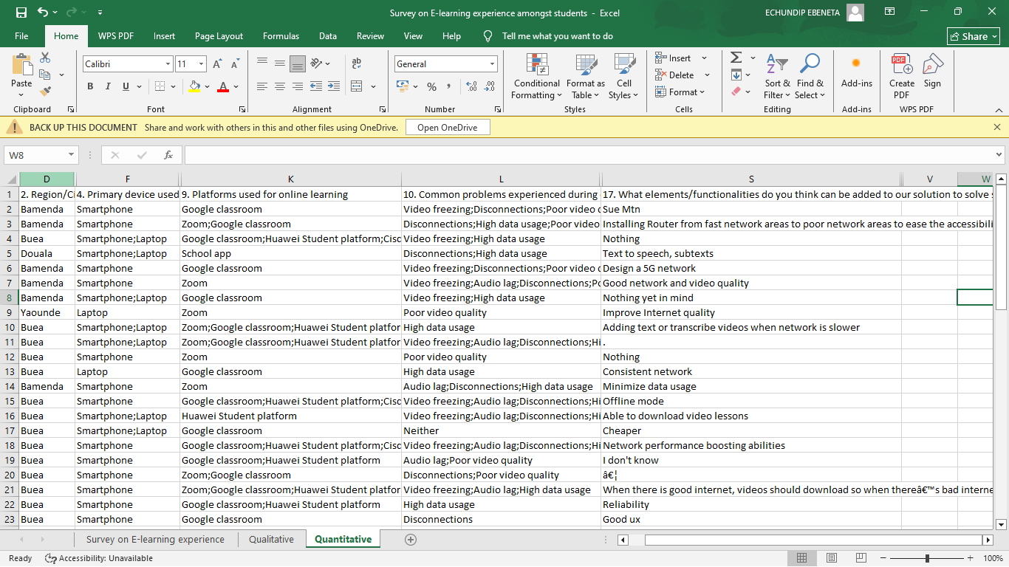
Data Virtualization:
Virtualization is mainly carried out to aid in identifying errors during the data cleaning process.
Here we simply represents data in multiple formats in other to see our progress during cleaning. This was done on excel
As seen
Quantitative e.g. “Open ended questions”:

Slide 13
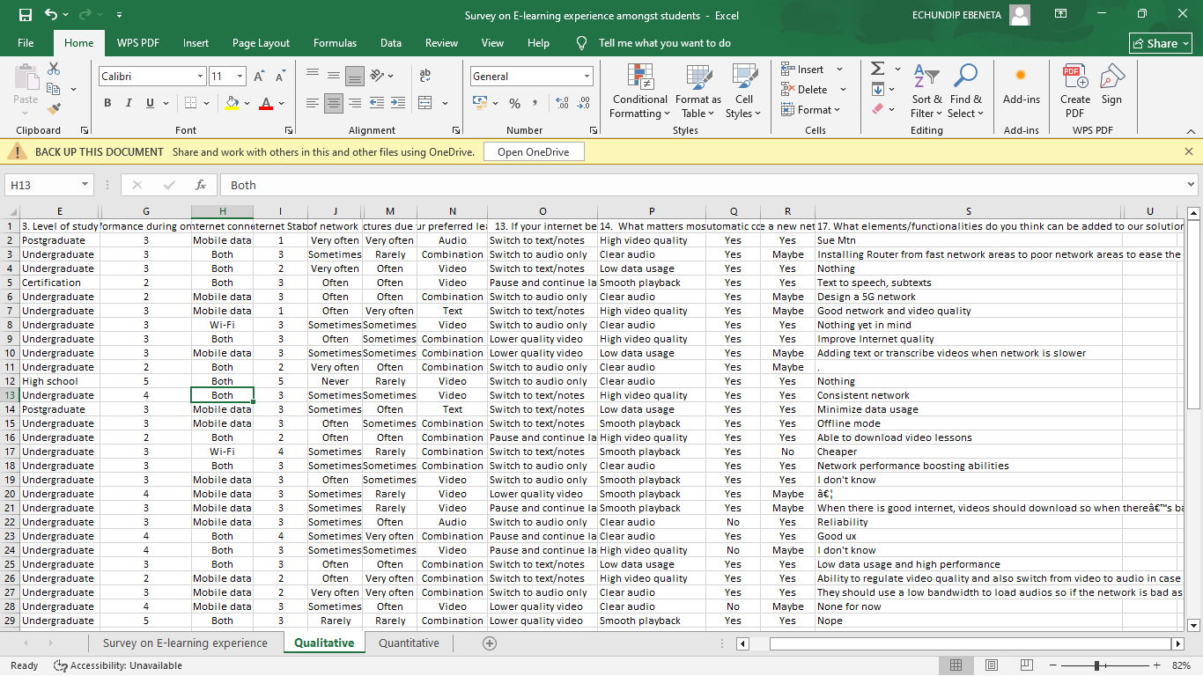
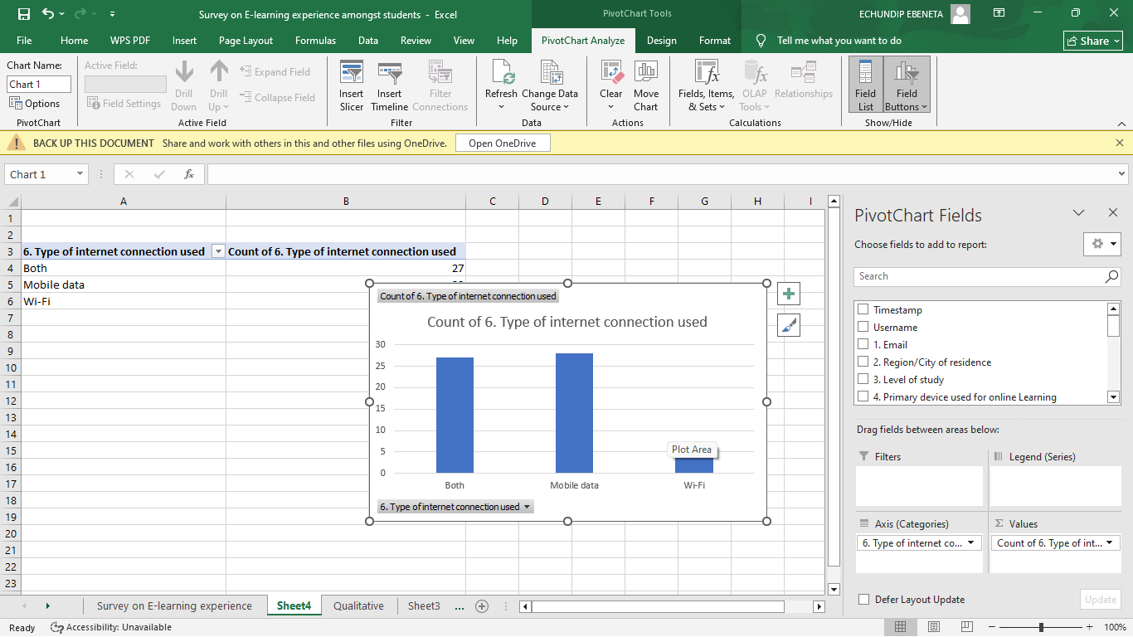
Qualitative: e.g. “On a scale of 1-10…”

Slide 14
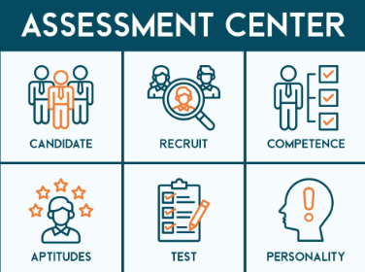
User Reluctance Assessment and Mitigation Strategies
User reluctance refers to the reasons why users may hesitate or refuse to use a mobile application.
Based on analysis and general user behaviour, several key reluctance factors have been identified.
High Data Costs
Poor Digital Literacy
Lack of Trust in New Platforms
Privacy Concerns

Slide 15
Mitigation Strategies
To ensure user acceptance and encourage active participation, the following strategies will be implemented:
Minimize Data Usage
Build User Trust
Optimize Battery Usage
Limit Notifications
Ensure Data Privacy and Security

